Slide 1
Feature Extraction in Head and Neck Tumor by CT Imaging

Slide 2
Introduction
Head and neck cancer represent the sixth most common malignancy worldwide, with around 800,000 new cases and 320,000 deaths in 2015 .
Worldwide, more than 500,000 patients are diagnosed with head and neck squamous cell carcinoma (HNSCC) each year
Head and neck cancer has high incidence in southern China especially in Hong Kong. Head and neck cancer incidence rate ranks sixth in males and the mortality rate ranks seventh in China
However medical imaging has helped in the diagnosis and treatment of Head and neck cancer
Head and neck cancers comprise a heterogeneous group of tumors arising from the oral cavity, pharynx, larynx, sinuses, and salivary and thyroid glands
Surgery is still one of the major treatment options for this disease, and with the primary aim of maximizing tumor removal while minimizing the damage to healthy tissue.
Surgery may cause unnecessary removal of normal tissues which can leave patients with functional and aesthetic problems
there are lots of chances that a diseased tissue is not completely removed, because of that cancer likely to recur or may cause another surgery.
Therefore, the tumor tissues are needed to be highly accurate for maximizing the efficiency of the surgical treatment and increase the chances of patient’s subsequent quality of life, both of which help in the cost savings.

Slide 3
Feature Extraction
It is a process of obtaining useful and desired information from the image.
Feature extraction is used to simplifying the amount of resources needed to describe a large amount of data accurately and efficiently.
Two types of texture feature considered in this study, like first-order and second-order statistics.
Consider intensity histogram in first-order and GLCM in second-order statistics.

Slide 4
Radiomics Workflow
High-quality and standardized imaging data must be collected.
Definition and segmentation of the ROI can be defined as In each subject or object, capture of radiomic imaging information can be performed using a manual, semiautomatic or automatic approach.
Radiomic feature are extracted from the tumor ROI concerning information related to image shape, intensity, and texture.
To understand clinical application, an efficient series of iterative processes is required for reproducible and consistent extraction of radiomics data
. The extracted features that gives the best performance, stability, or other defining metric are then selected for the further use in clinical applications﻿.

Slide 5
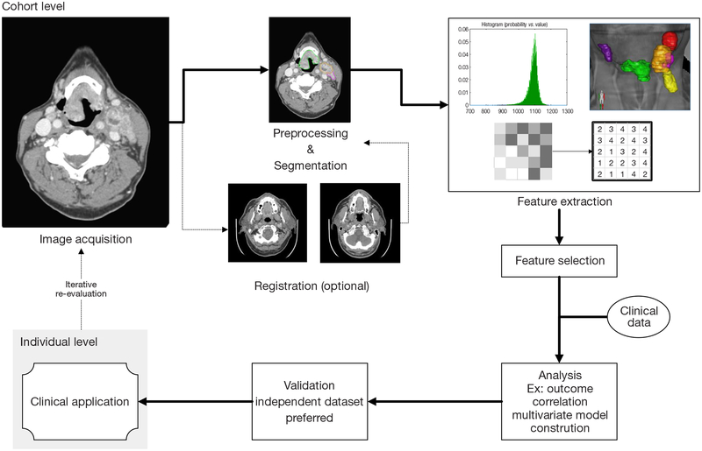

Slide 6
Materials and Methods
Dataset
Collected the small of head and neck cancer patients dataset, which contains 28 patients.
Each patient folder contains two subfolders. One folder contains the multiple DICOM standard images of that patient and another subfolder contains RTSS.mat file which contains the information about the segmentation of each image of the patient.
Computed tomography scan (CT)
Enhanced computed tomography (CT) is a common methods for diagnosing head and neck cancer.
CT has the advantages of simplicity, rapidity, and wide availability
It has the disadvantage of radiation exposure, which is not appropriate for patients with iodine allergy or severe renal insufficiency.

Slide 7
DICOM STANDARD
Imaging and Communication in Medicine (DICOM) is a standard for storing, handling, printing, and transmitting information between the digital imaging computer systems in medical environments.
DICOM files can be exchange between two entities that are capable for receiving image and patient data in DICOM format.
DICOM information object consists of variety of attributes, together with things like name, ID etc., and conjointly one special attribute containing the image pixel.
RTSS.mat
Files with the . mat extension are files that are in the binary data container format that the MATLAB program uses. The extension was developed by Mathworks and MAT files are categorized as data files that include variables, functions, arrays and other information.DICOM files can be exchange between two entities that are capable for receiving image and patient data in DICOM format.
mat73 library loads MATLAB 7.3 HDF5 files into a Python dictionary. import mat73 data_dict = mat73.loadmat(‘FileName.mat ’).

Slide 8
IMPLEMENTATION OVERVIEW
I have used Python 3.5.0 to implement the head and neck cancer feature extraction.
Installed Pydicom for reading the DICOM (Digital Imaging and Communications in Medicine) files.
Installed OpenCV for manipulating the image like resizing the image.
Installed MatPlotLib for visualization of the image files and various presentation purposes.
Installed pandas (used for reading operations on csv files and computation of confusion matrix), os (File and directory manipulations), scikit-learn (to compute confusion matrix) ,
Installed mat73 to read .mat file
Installed numpy to work with numpy array
Installed glob to get the list of directories and files inside the folder
Installed xtract_features to extract some features
Installed scipy.stats to get skew and kurtosis etc.

Slide 9
Working Process
Created four empty folders in each patient’s folder named image will contain jpg CT images, masks will contain jpg masks , masked will contain masked jpg images and overlayed will contain combined jpg images of CT images and masks images for visualization.
For big data set we can not create these multiple folders for each patients. I have implemented code so that we do not need to create these folders. Only one folder will be required. One can review the code to check the implementation.
Converted all dicom images to nparray and putting all arrays to npy file.
Extracted the countour segmentation from the RTSS.mat file using mat73 library.
Extracted the segmentations which consist ROI(Region of interest).
As we have ROI and head and neck cancer nparray we can mask them to get masked array and simultaneously I am converting all arrays to images and saving them in metioned folders for visualization.
masking= diocom_img_array[i] * ROI_array[i]

Slide 10
As images saved in folders we can combine images and masks to see the overlayed images too.
Overlayed_img= cv2.addWeighted(dicom_img_array, 0.5, mask_img, 0.5, 0)
Also we get the masked images for which we need to extract the features.
To Extract the feature from masked image we first convert it into gray scale image.
gray_img = cv2.cvtColor(masked_img, cv2.COLOR_BGR2GRAY)
Now using calculation and various libraries we can extract different features easily.
By iterating all the patient’s folder using for loop we can extract all features.
Using Pandas library we can read dataframes and save them into csv file.
Similarly using pandas we can combine all csv files into one.

Slide 11
Feature Extraction
It is a process of obtaining useful and desired information from the image.
Feature extraction is used to simplifying the amount of resources needed to describe a large amount of data accurately and efficiently.
Two types of texture feature considered in this study, like first-order and second-order statistics.
Consider intensity histogram in first-order and GLCM in second-order statistics.

Slide 12
The first order (Intensity of Histogram)
The first- order statistics are intensity histogram and intensity features.
Histogram is the probability of occurrence of a pixel of particular grey level (intensity)
The main advantage of the histogram is its simplicity by the use of standard descriptors such as mean and variance to characterize texture data.
It included mainly properties like as :
mean,
varience,
skewness,
kurtosis,
Entropy

Slide 13
Second Order(GLCM)
GLCM stands for gray level co-occurrence matrix where the number of rows and columns is equal to the number of distinct gray levels.
The co-occurrence matrix is also known as second-order histogram that analyses the grey-level distribution of pairs of pixels.
In grey-level co-occurrence matrix method, the probability of finding a pixel with a defined grey level at a defined distance and a defined angle from another pixel with defined grey level is calculated.
Generally, it consists of fourteen features. Out of these, only four features used in this study.
GLCM Features
Correlation
Homogeneity
Energy
Contrast

Slide 14
Moments
Image moments are helpful in describing objects after segmentation and play a necessary role in object recognition and shape analysis.
Simple image properties are extracted via raw moments which is area or sum of grey levels.
Image moments can be described as weighted average of image pixel intensities
HU Moments
Hu moment invariants or Hu moments are a set of 7 numbers which are calculated using central moments that are invariant to image transformations.
The first six moments have been proved to be invariant to translation, scale, and rotation, and reflection. whereas the seventh moment’s sign changes for image reflection.
Hu moment will be constant for a given shape, no matter how it's shifted, rotated, or scaled.
Moments is a list of 24 variant moments and hu moments is list of the 7 hu moments which are invariant.

Slide 15
Region Properties(Geometry)
Image regions, also known as objects, connected components, or blobs, have properties such as area, center of mass, orientation, and bounding box.
There are many region properties such as :
Maximum area occupancy
Eccentricity of the max area region
Euler number of the max area region
Solidity of the max area region
Perimeter of the max area region
Mean of all the areas of all the segmented regions
Standard deviation of areas of all the segmented regions
The otsu threshold of the image
Coordinates of the boundary box of the max area region

Slide 16
Area of the boundary box.
Centroid of the max area region
Convex area of the max area region
Coordinates of the max area region
Equivalent diameter of the max area region
Filled area of the max area of the region
Inertia tensor of the max area region
Eigen values of the inertia tensor of the max area regions
Label of the region
Local centroid of the max area
Major axis length of the ellipse of the max area region
Minor axis length of the ellipse of the max area region
The orientation

Slide 17
2D Convolutions
For edge detection, sharpening and blurring the image we use 2D convolutions
. kernel In image processing is a convolution matrix or masks which can be used for blurring, sharpening, embossing, edge detection and more by doing a convolution between a kernel and an image.
Convolution is using a ‘kernel’ to extract certain ‘features’ from an input image.
There are 14 convolution kernels/matrices available inside the package as follows,
identity, edge-all, edge-H, edge-V, sharp, gauss-3, gauss-5, boxblur, gradient-H, gradient-V, sobel-H, sobel-V, emboss

Slide 18
References
All the reference are already mentioned in the paper, here are some important links which helps me to understand the workflow of radiomic.
https://www.nccn.org/professionals/physician_gls/default.aspx
https://www.intechopen.com/books/pattern-recognition-analysis-and-applications/histogram-based-texture-characterization-and-classification-of-brain-tissues-in-non-contrast-ct-imag
https://pyradiomics.readthedocs.io/en/latest/_modules/radiomics/firstorder.html
https://pyradiomics.readthedocs.io/en/latest/features.html#module-radiomics.glcm
https://www.spcforexcel.com/knowledge/basic-statistics/are-skewness-and-kurtosis-useful-statistics
https://medium.com/@thevatsalsaglani/feature-extraction-from-medical-images-and-an-introduction-to-xtract-features-9a225243e94b
https://buildmedia.readthedocs.org/media/pdf/pyradiomics/v1.0.1/pyradiomics.pdf
http://www.ajnr.org/content/suppl/2011/07/12/ajnr.A2232.DC1/2232_table.pdf
https://www.learnopencv.com/shape-matching-using-hu-moments-c-python
https://in.mathworks.com/help/images/pixel-values-and-image-statistics.html
https://github.com/ninn55/python-regionprops
https://in.mathworks.com/help/images/ref/regionprops.html
https://www.ncbi.nlm.nih.gov/pmc/articles/PMC6322843/figure/F1/
http://tcr.amegroups.com/article/view/8805/html
https://www.cancer.net/cancer-types/head-and-neck-cancer/view-all

